Slide 1
Look around and be grateful for what you have. Some don’t have what you take for granted…

Slide 2
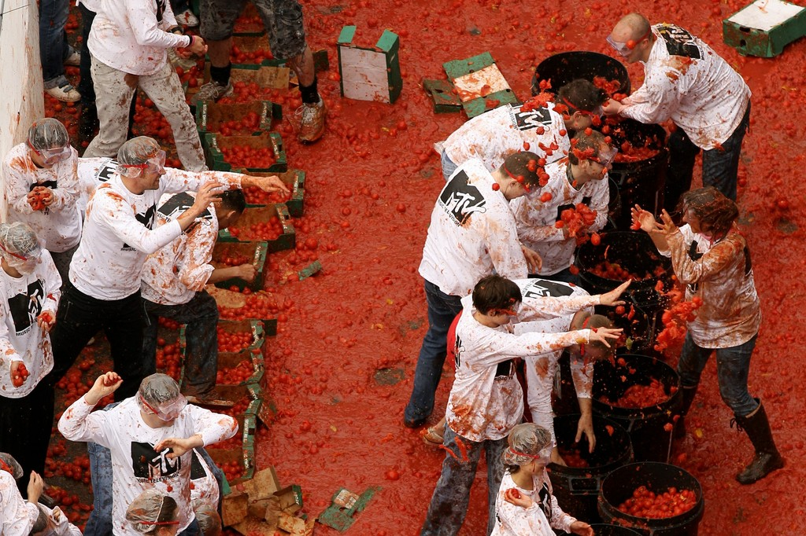

Slide 3
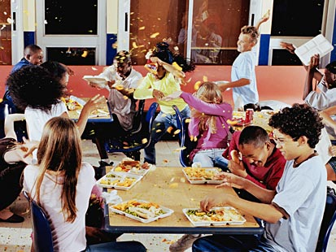

Slide 4
You have Food Fights, while others will fight for food…

Slide 6
Hunger in our homes is not even heard of. But for 1 in 6 people in the United States, hunger is a reality.

Slide 11
It’s Not Just in America, all across the world people suffer from starvation…

Slide 13
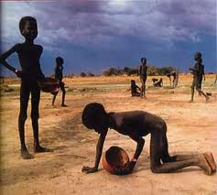

Slide 18
Seven states exhibited statistically significant higher household food insecurity rates than the U.S. national average 2009-2011:
United States 14.7%
Mississippi 19.2%
Texas 18.5%
Arkansas 19.2%
Alabama 17.4%
Georgia 17.4%
Florida 16.2%
North Carolina 17.1%

Slide 30
In 2011, 50.1 million Americans lived in food insecure households, 33.5 million adults and 16.7 million children.

Slide 37
Women make up a little over half of the world's population, but they account for over 60 percent of the world’s hungry.

Slide 38
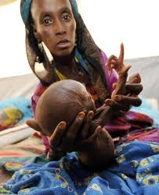

Slide 40
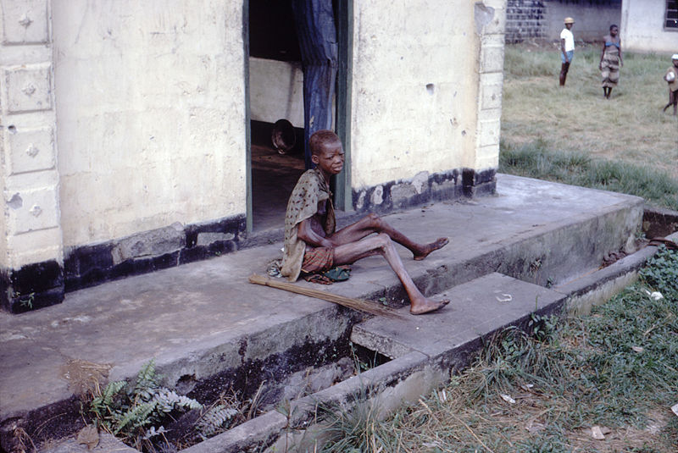

Slide 42
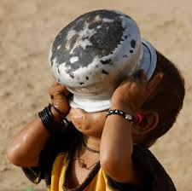

Slide 45
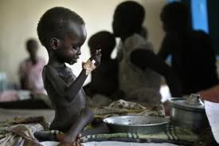

Slide 49
It Doesn’t Have To Be This Way!
GET INVOLVED!

